Slide 1

Plotting the Lorentzian Function
$$z\left(f\right)=\frac{Ae^{iθ}}{f−f_{0}+iγ}$$
$$Re[z\left(f\right)]=\frac{A}{{(f−f_{0})}^{2}+γ^{2}}\left[\left(f−f_{0}\right)\cos{θ}+γ\sin{θ}\right]$$
Im$[z\left(f\right)]=\frac{A}{{(f−f_{0})}^{2}+γ^{2}}i[\left(f−f_{0}\right)\sin{θ}−γcos{θ}$]
Notes:
The fanciest of fancy. Although powerpoint refuses to format the two equation the same. Damn you powerpoint!

Slide 2
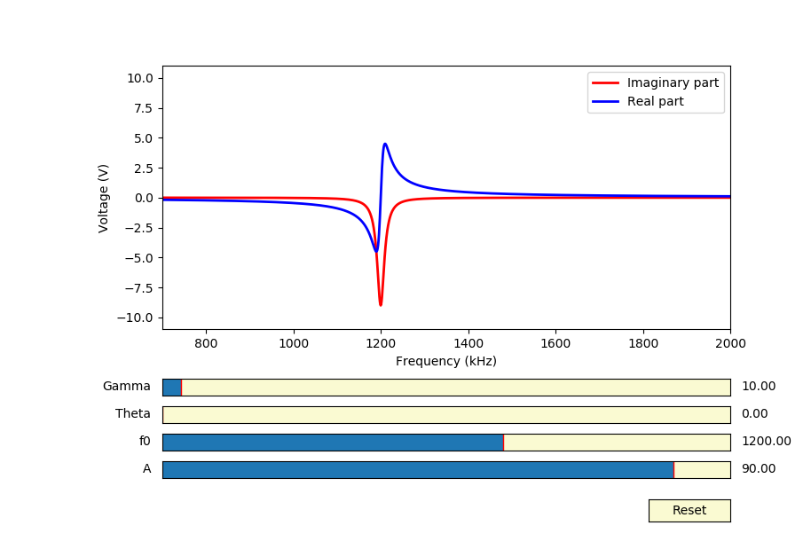
Default Values (Values except theta are arbitrary)
‘f0’ translates the function along the x axis.
‘A’ changes the amplitude.
Notes:
I used my DnD dice to roll starting values, except for f0. That one I was just lazy about.

Slide 3
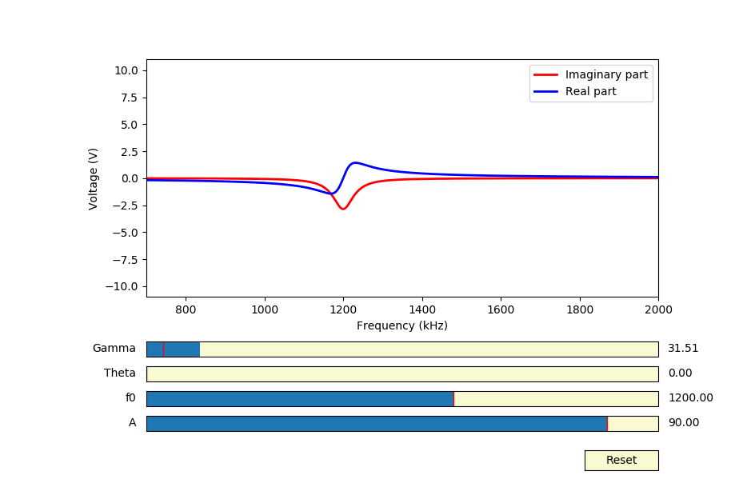
Increasing γ by ~20 kHz
Notes:
I’ll be honest, I don’t remember what the actual scale for gamma is. Not knowing really hertz my confidence.

Slide 4
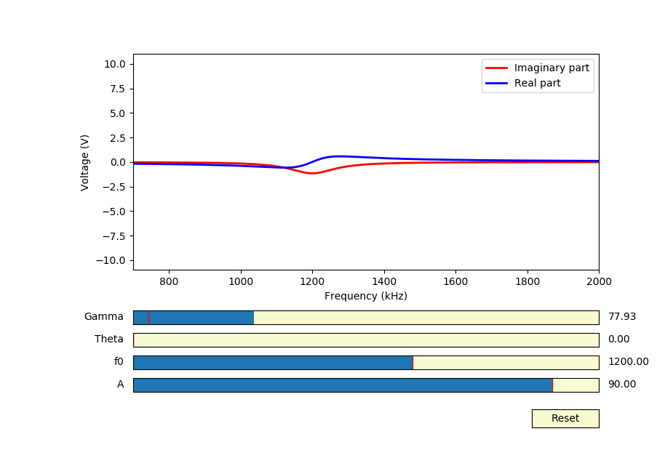
Increasing γ by ~67 kHz
Notes:
We could have gone further, but two slightly overlapping straight lines is only slightly more interesting than a blank graph.

Slide 5
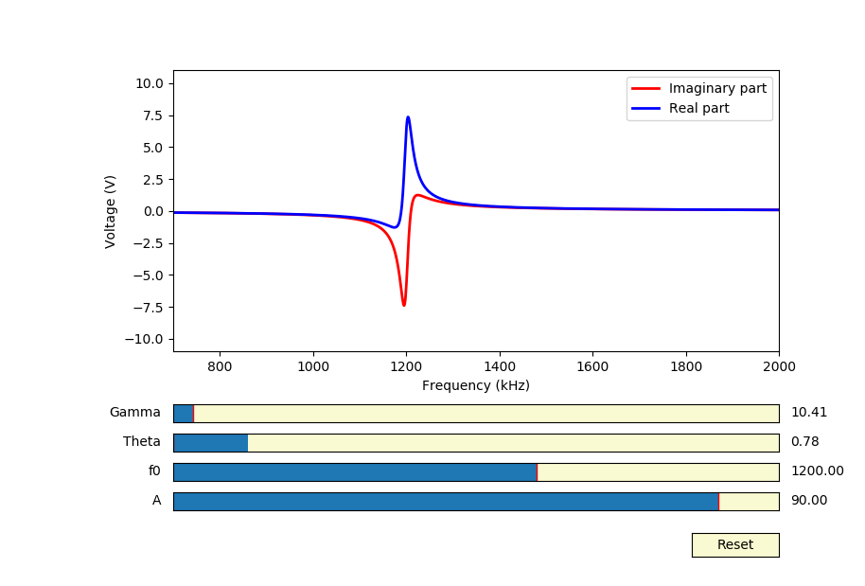

$$θ= \frac{π}{4}$$
Notes:
I really have nothing to say about this one.

Slide 6
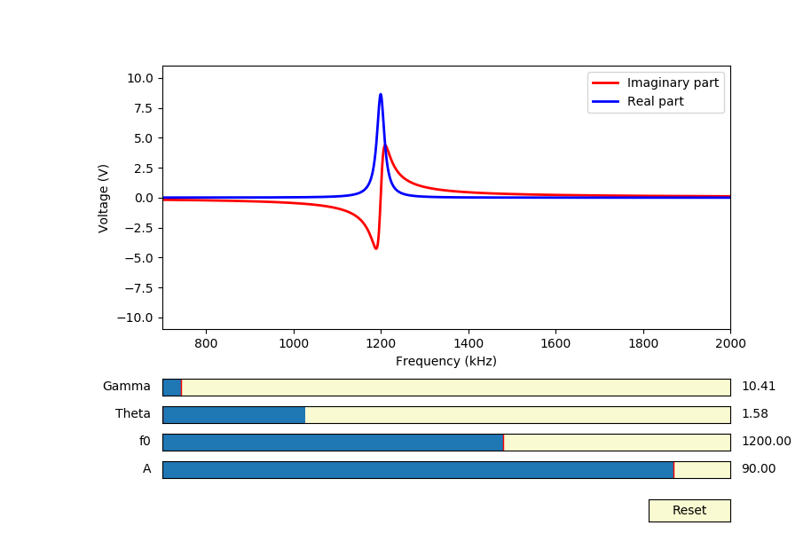

$$θ= \frac{π}{2}$$
Notes:
Now I’m thinking about pie. Kind of hungry now…

Slide 7
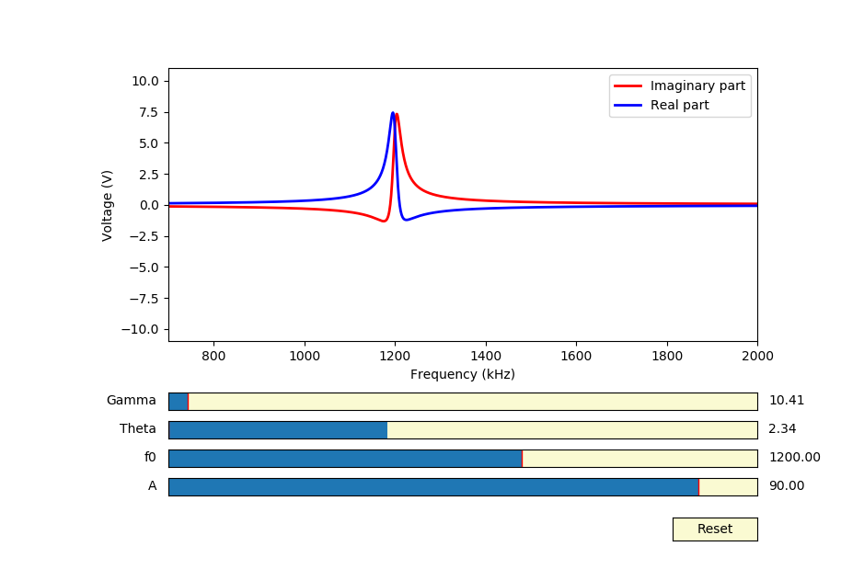

$$θ= \frac{3π}{4}$$
Notes:
I like how they become symmetric at 45 degrees. If only the world were perfectly symmetric. If only I could MAKE the world the world symmetric.

Slide 8
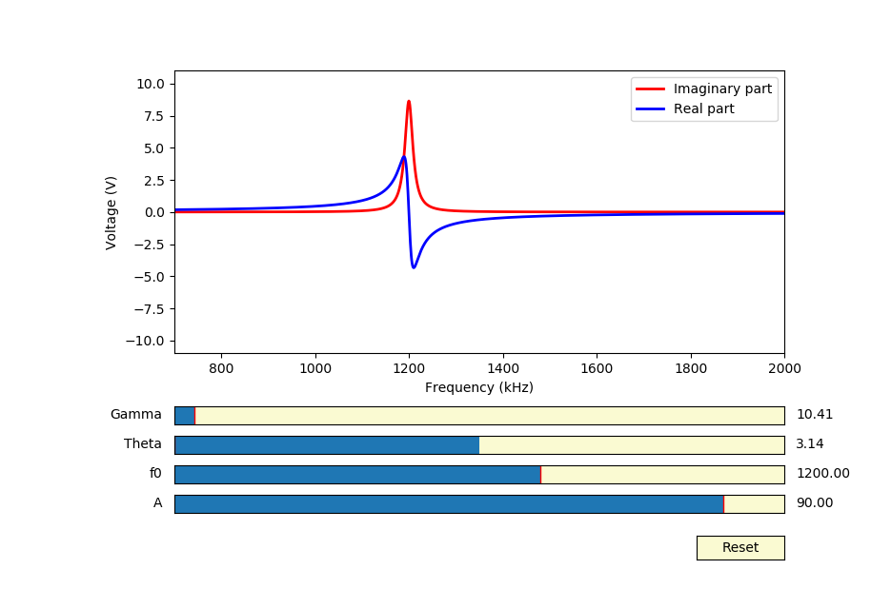

$$θ=$$
Notes:
That last one came out kind of supervillainy. I’m not a supervillain, but if I was I would try to be a benevolent-ish dictator kind of supervillain.

Slide 9
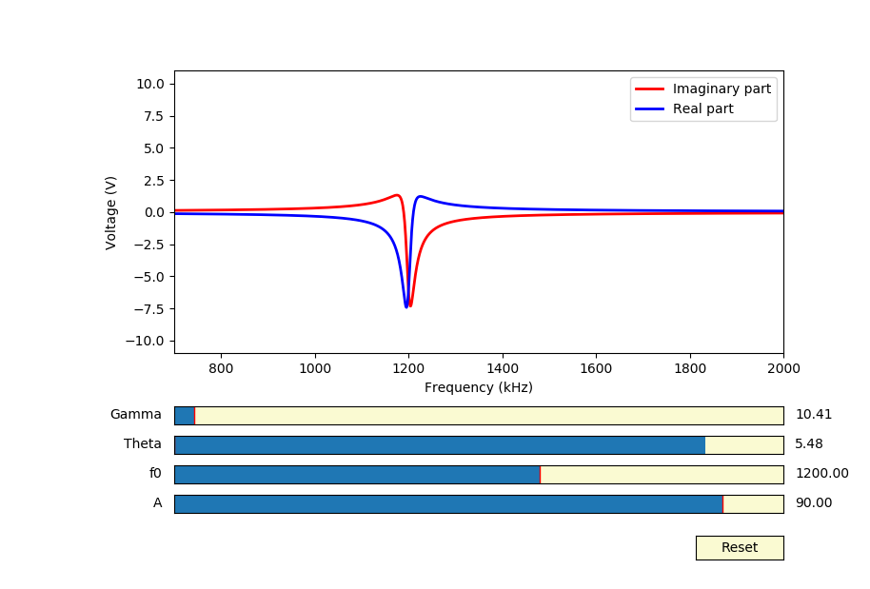

$$θ= \frac{7π}{4}$$
Notes:
Thank you for going through this crummy powerpoint filled with plot wholes and speeling misteaks.

